Slide 1
Web Design
CS/IT 490 WD, Fall 2013

Slide 2
Layout
It is important to have a good layout on your website that is cross-browser compatible, and even mobile compatible.
You might have separate styles for a desktop vs. a mobile device.
For each environment, it should be simple and intuitive to navigate your website.

Slide 3
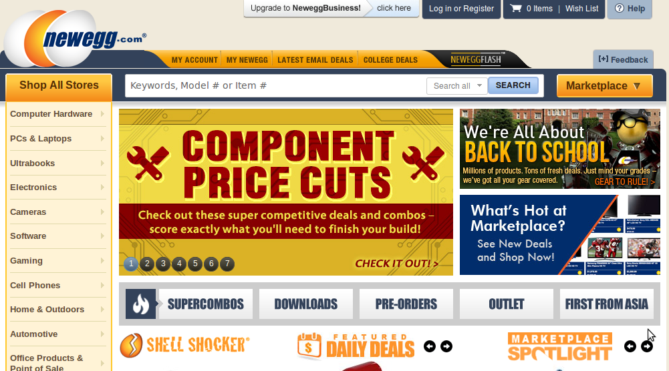
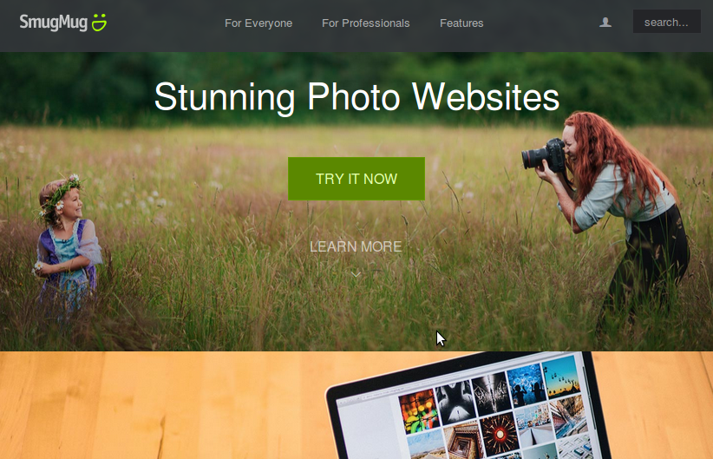
Layout
An attractive page may also be important for your site...
Or maybe not...
Newegg.com
Smugmug.com

Slide 4
Layout
Either way, it should be easy for the user to get to where they want to go.
Your page may include
  Nav bar
  “Featured” links on the front page
  A Gallery on the front page
  A sitemap link in the footer
  Etc.

Slide 5
Layout Examples
This site has a good breakdown of some modern-looking design layouts:
http://designshack.net/articles/layouts/10-rock-solid-website-layout-examples/
Try to study existing websites and adopt design elements from them.
  Look at sites with a similar audience or function to your own.
  Look at design blogs.
  Experiment with colors and fonts.
  Experiment with whitespace.

Slide 6
Color theme
Color theme can be a hard subject to tackle in web design.
There are sites like “Color Scheme Designer”
http://colorschemedesigner.com/
Keep it simple – White is a very safe color for your primary. It looks clean and open!

Slide 7
Investigating Existing Pages
Notice...
Does this have more of a horizontal or vertical flow?
Does it have a lot of borders to section the page, or does it feel open?
How does it effectively use rows AND columns?
What are its primary colors?
How is the nav-bar laid out?
What content is featured on the front page? What is above the fold?
Sample websites...
https://www.khanacademy.org/
http://www.w3schools.com/
http://makerfaire.com/
http://marketplace.xbox.com/en-US/
http://www.thinkgeek.com/
http://www.garmin.com/en-US/
https://www.silpada.com/public/home.jsf
http://www.perceptivesoftware.com/

Slide 8
Ought-to-haves
Important content above the fold
Detailed footer
Breadcrumbs

Slide 9
Ought-to-haves
Above the Fold
This is the area that the user can see without scrolling down on a page.
Generally the most important content!

Slide 10
Ought-to-haves
Above the fold:
A few examples

Slide 11
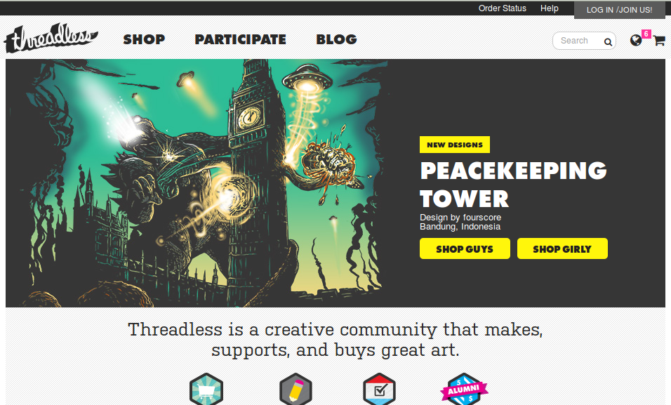
Above the Fold
Order Status
& Login!
Simple Nav
Search &
Cart!
This thing looks
like your unread
Facebook feed
Targetting your
impulse to click
OMG NEW MESSAGES
Buy this thing!
Who we are!
Threadless.com

Slide 12
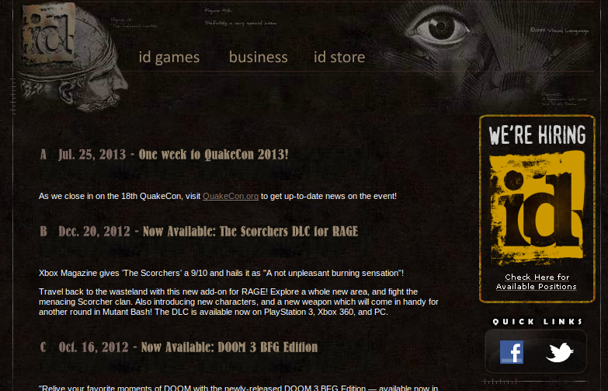
Above the Fold
Super simple nav
id-related news!
Work for us!
Social media!
Idsoftware.com

Slide 13
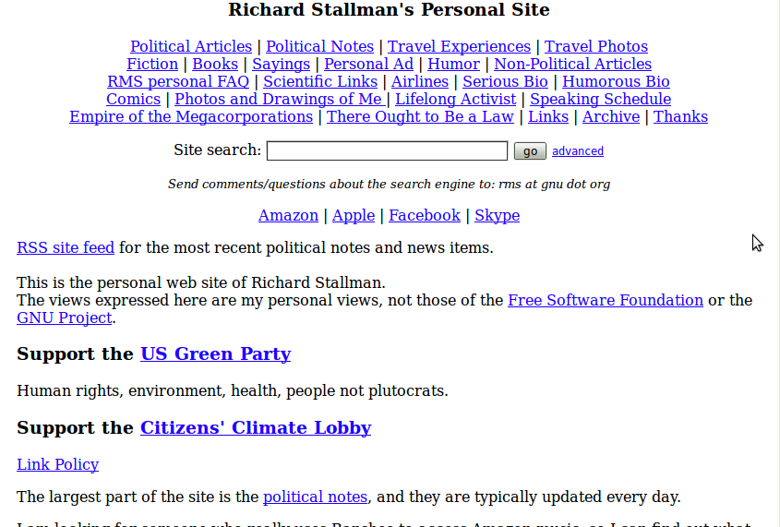
Above the Fold
RMS doesn't
Want no CSS!
Look at all these
clickable things,
separated by pipes!
Seems weird that these
are linked here.
Support stuff!
stallman.org

Slide 14
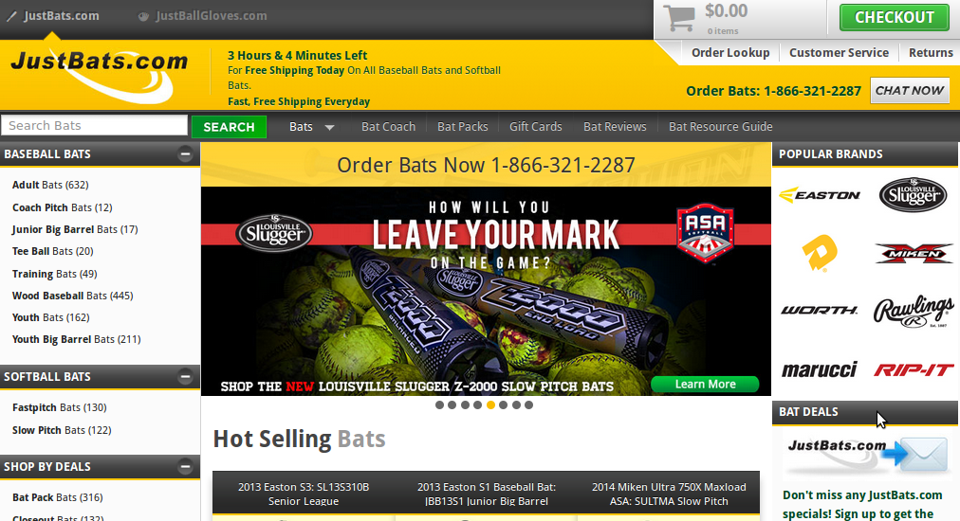
Above the Fold
Check out the sale!
CALL US!
Buy these!
Everyone
Likes these!
Various
Filters!
Get our
Email blasts!
People buy
These bats
Justbats.com

Slide 15
Ought-to-haves
Detailed Footer
A Website Footer Is For More Than Your Copyright Notice
http://www.bourncreative.com/a-website-footer-more-than-a-copyright-notice
Investigate other websites and what they have...
  Privacy policy, about, additional links
  Address, contact information
  Social media links or embedded plugins
  Site map link, links repeated from navbar.

Slide 16

Ought-to-haves
Breadcrumbs!
  Help the user backtrack through their progress. Generally lists hierarchical order.
Justbats.com
Amazon.com
Newegg.com

Slide 17
Common Elements
Feature Scroller
  Pretty common, scrolls through large image banner “features” that link to various products or parts of the website.

Slide 18

Common Elements
Feature Scroller
x
theroasterie.com

Slide 19
Common Elements
Social Media / RSS Feed Links
Embedded maps, as needed
Company News
Contact form
  Rather than giving an email address, allow to add extra metadata – topic, return info, etc.

Slide 20
“Hidden” Elements
Content Management System (CMS)
  Where the website employees update the website.
  Or, where customers who have purchased a service are able to update settings.
  If you have a blog, think of your settings control panel & new blog post interface.

Slide 21
“Hidden” Elements
Object-Relational Mapping (ORM)
  An extra layer between your server code and the database.
  Keeps you from writing SQL code and handling queries manually.
  Generally gives you class object representations of your tables/schema.
    Customers->FilterBy( “last_name” )

Slide 22
Tools
960 Grid System
http://960.gs/
  Keep your website conforming to a grid-layout, easily style your page.
LESS CSS
http://lesscss.org/
  Add variables, operations, and functions to your CSS.
Bootstrap
http://getbootstrap.com/2.3.2/
  CSS framework

Slide 23
Design Blogs
Look at design blogs for ideas
http://www.smashingmagazine.com/2007/08/28/45-excellent-blog-designs/
http://bestwebgallery.com/
http://www.webcreme.com/

Slide 24
References
-

